Slide 1
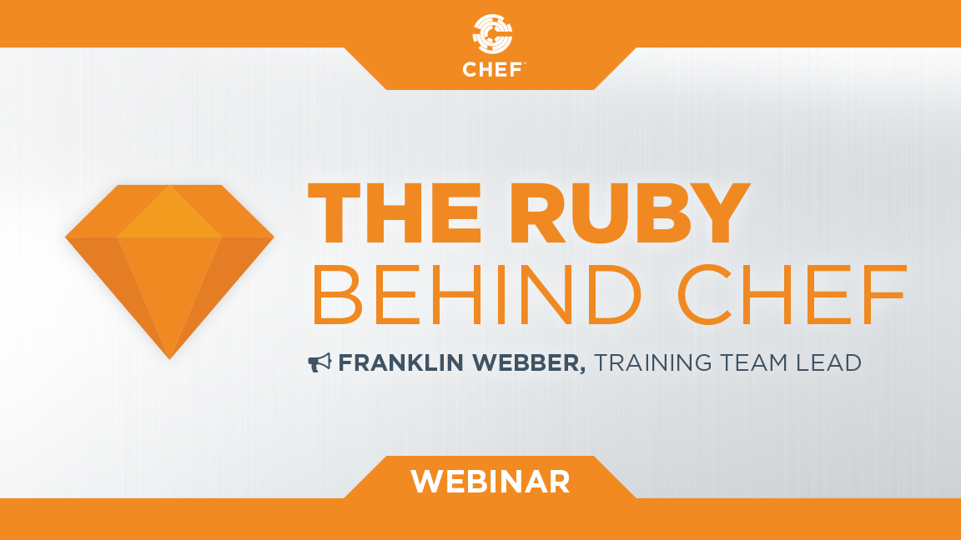
The Ruby Behind Chef
Notes:
Hello everyone and welcome to today’s webinar: ‘The Ruby Behind Chef'

Slide 2

Franklin Webber
Ceci n'est pas un entraîneur
Notes:
My name is Franklin Webber. I'm a training lead here at Chef and I’m honored that you chose to be a part of this session today.

Slide 3
My Ruby Journey
Present Day
August 2009
October 2010
January 2011
March 2011
TIME
August 2009
October 2010
January 2011
March 2011
Present Day
Hired at Globys. Started learning Ruby
Released 'cucumber-in-the-yard' gem
Take job as Ruby on Rails Developer
Re-release gem as 'yard-cumber'
Released 18 gems
Notes:
My name is Franklin Webber. I'm a training lead here at Chef and I’m honored that you chose to be a part of this session today.

Slide 4
My Ruby Journey
Present Day
August 2009
October 2010
January 2011
March 2011
TIME
1 year, 2 months or 60 weeks
60 weeks * (5 days/1 week) * 4 hours/day = 1200 hours
Notes:
My name is Franklin Webber. I'm a training lead here at Chef and I’m honored that you chose to be a part of this session today.

Slide 5
Who I Think You Are ...
Chef Cookbook Author
Write cookbook recipes and define attributes
Curious about Ruby || Frustrated with Ruby
Understanding of some programming concepts (e.g. variables, functions/methods)
Notes:
When creating this presentation I spent a lot of time thinking about who you are to help guide me in preparing the best content to assist you and to define the scope of what to share with you.
First and foremost I made the assumption that you are an author or co-author of cookbooks. By that I mean you have edited or created recipes and defined attributes. During your time working with Chef you have been confronted with errors you did not understand or implementations within community cookbooks that were perplexing. Which has made you curious and maybe even simultaneously frustrated with your lack of understanding of Chef and Ruby.
I also am making an assumption that you have some experience working with some software programming concepts; whether you started learning a little bit of Ruby, Perl, Python, Java, or C#.

Slide 6
Schedule
NOW – Introduction
@ 5 min – A Look Behind Resources
@ 20 min – A Look Behind Attributes
@ 35 min – The Power of Mixins
@ 45 min – Questions
@ 55 min – Resources and Wrap-up
Notes:
This is the schedule of what we are going to talk about during our time together. We are currently covering the housekeeping items in this introduction. I will do my best to adhere to this schedule to ensure those of you watching this after the fact or reviewing this material will have a better idea of where to skip around to best get the learning concepts you need.

Slide 7
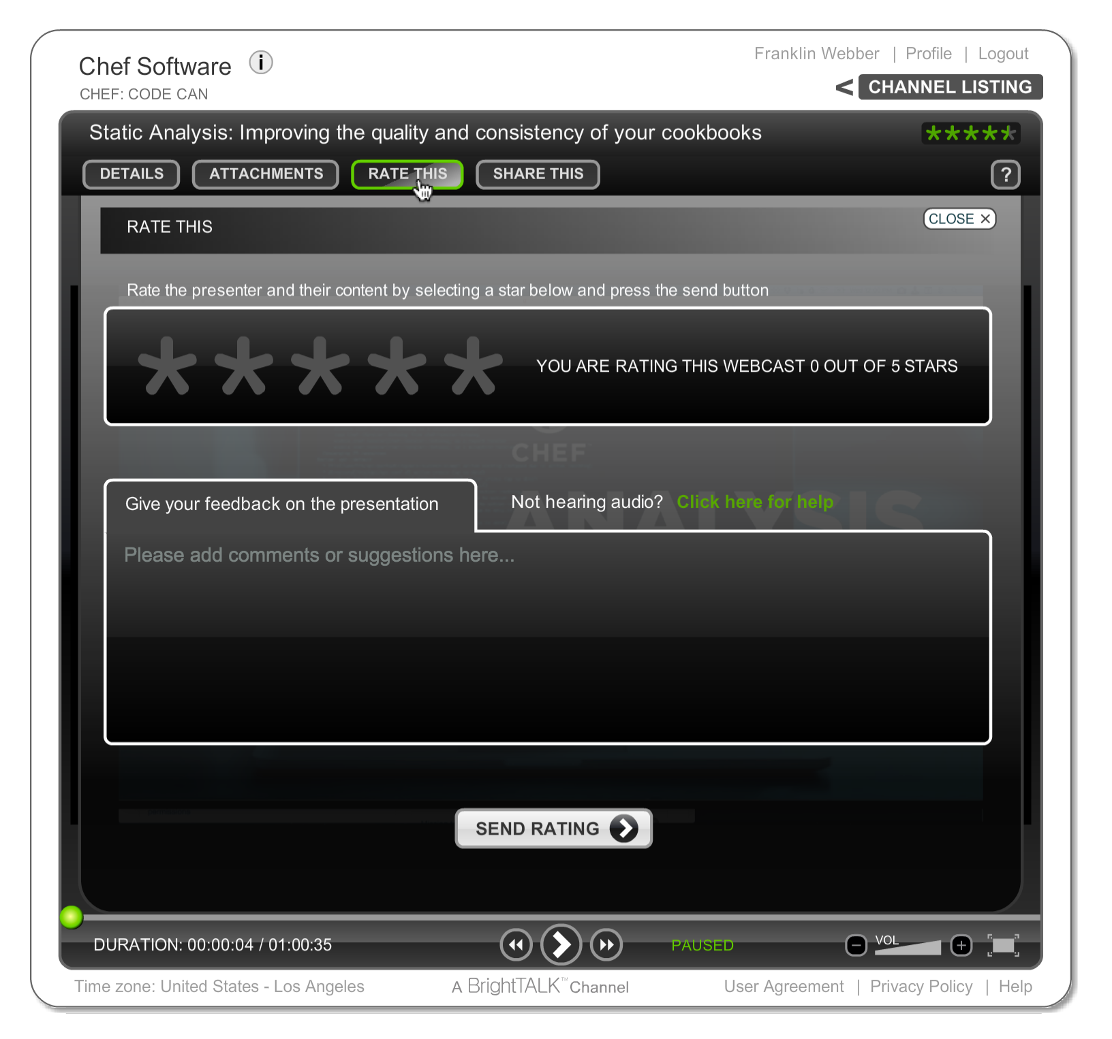
Let Us Know What You Think
"Ask a Question" and I will answer it.
"Rate This" presentation to leave your feedback and help me do my work better.
Email me at franklin@chef.io
Notes:
We’d love to hear from you during today’s presentation. I’ll be answering questions at the end of the session, so please feel free to send those along using the ‘Ask a Question’ tab on the top of your screen.

Slide 8
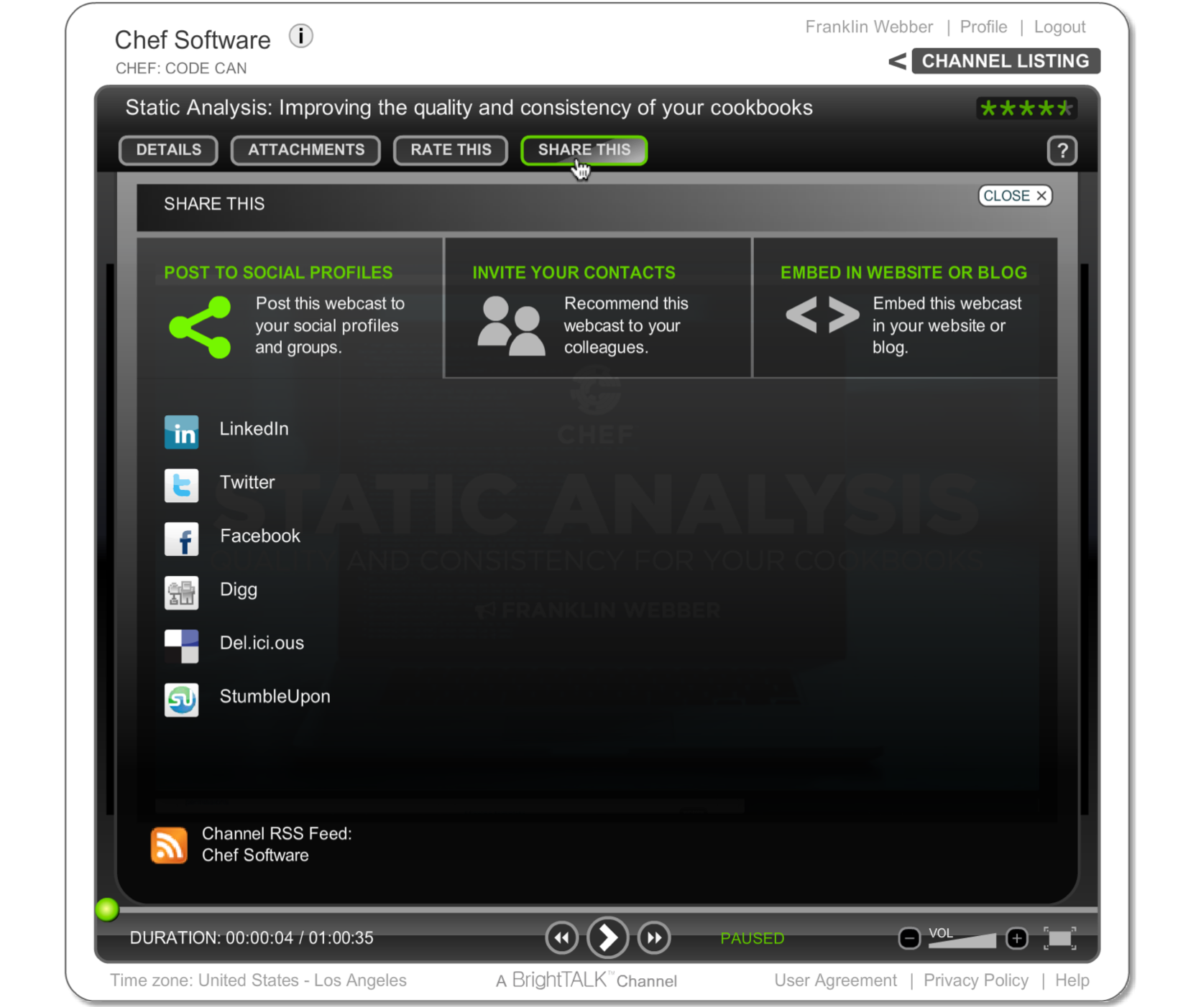
Was this Valuable to You?
Share it with your professional and social networks.
Notes:
Today’s webinar will be available on demand after the live session, accessible through the same link you’re using now.

Slide 9
The Ruby Behind Chef
Notes:
Hello everyone and welcome again to today’s webinar: ‘The Ruby Behind Chef.’

Slide 10
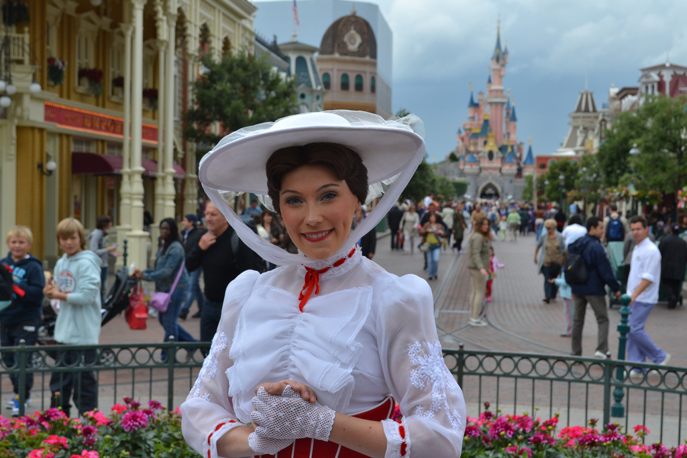
A Spoonful of Sugar ...
"She’s sometimes quirky, always beautiful, a little mysterious, and absolutely magical. Think Mary Poppins, the British nanny."
https://flic.kr/p/9XE4qy
- Seven Languages in Seven Weeks, Bruce A. Tate, p 27.
PHOTO CREDIT: LOREN JAVIER | flic.kr/p/9xe4qy
Notes:
Ruby is like Mary Poppins

Slide 11
Agenda
A Look Behind Resources
A Look Behind Attributes
The Power of Mixins
Questions
Further Resources

Slide 12
Resources
file '/hello.txt' do
content 'Hello, world!'
action :create
end
The TYPE named NAME should be ACTION'd with PROPERTIES
The file named '/hello.txt' should be created with content 'Hello, world!'

Slide 13
Resources
file '/hello.txt' do
content 'Hello, world!'
action :create
end
The TYPE named NAME should be ACTION'd with PROPERTIES
The file named '/hello.txt' should be created with content 'Hello, world!'

Slide 14
Resources
file '/hello.txt' do
content 'Hello, world!'
action :create
end
The TYPE named NAME should be ACTION'd with PROPERTIES
The file named '/hello.txt' should be created with content 'Hello, world!'

Slide 15
Resources
file '/hello.txt' do
content 'Hello, world!'
action :create
end
The TYPE named NAME should be ACTION'd with PROPERTIES
The file named '/hello.txt' should be created with content 'Hello, world!'

Slide 16
Resources
file '/hello.txt' do
content 'Hello, world!'
action :create
end
The TYPE named NAME should be ACTION'd with PROPERTIES
The file named '/hello.txt' should be created with content 'Hello, world!'

Slide 17
A Ruby Method with One Parameter
def file(name)
# contents of method
end
The method named 'file' has a single parameter named 'name'.

Slide 18
Variables
In computer programming, a variable or scalar is a storage location paired with an associated symbolic name (an identifier), which contains some known or unknown quantity of information referred to as a value.
https://en.wikipedia.org/wiki/Variable_(computer_science)

Slide 19
Blocks in Ruby
Think of it as a way to pass code you can execute instead of a value. Some people might call them anonymous functions. This is because blocks have code that they execute but not have been given a name.

Slide 20
A Ruby Method Always has a Block
def file(name,&block)
# contents of method
end
The method named 'file' has a single parameter named 'name' and explicitly names the block 'block'. (The & in front is a way to grab that block).

Slide 21
A Ruby Method Always has a Block
def file(name,&block)
# invoking the block with the explicit name
block.call
# or the implicit invocation
yield if block_given?
end
A block can be invoked with the explicit name or with the implicit block syntax.

Slide 22
Passed Blocks Become Procs
Proc objects are blocks of code that have been bound to a set of local variables. Once bound, the code may be called in different contexts and still access those variables.
rubydoc.info/stdlib/core/Proc

Slide 23
A Ruby Method and the Lazy Hash
def supports(parameters)
# contents of method
end
supports :restart => true, :reload => true
supports { :restart => true, :reload => true }
The method named 'file' has a single parameter named 'parameters'. The argument specified is a Hash (even without the curly braces).

Slide 24
A Ruby Method, Params, and the Lazy Hash
def rights(permission, principal, options)
# contents of method
end
rights :read, 'MORDOR\Minions, :option_1 => 'details'
Only the last parameter can be this 'lazy' Hash.

Slide 25
Agenda
A Look Behind Resources
A Look Behind Attributes
The Power of Mixins
Questions
Further Resources

Slide 26
Agenda
A Look Behind Resources
A Look Behind Attributes
The Power of Mixins
Questions
Further Resources

Slide 27
Agenda
A Look Behind Resources
A Look Behind Attributes
The Power of Mixins
Questions
Further Resources

Slide 28
Let Us Know What You Think
Email me at franklin@chef.io
"Rate This" presentation to leave your feedback and help me do my work better.

Slide 29
Q&A
What questions can I answer for you?

Slide 30
Agenda
A Look Behind Resources
A Look Behind Attributes
The Power of Mixins
Questions
Further Resources

Slide 31
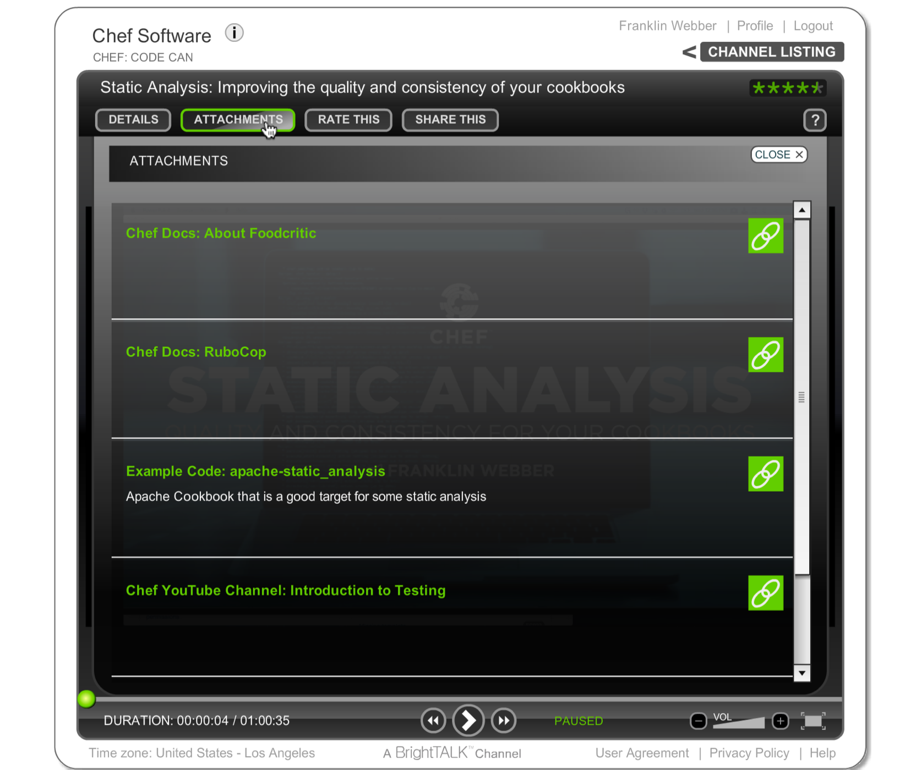
BrightTALK Attachments
All of the resources I am going to provide you can be found under "Attachments".

Slide 32

exercism.io
Level up your programming skills

Slide 33
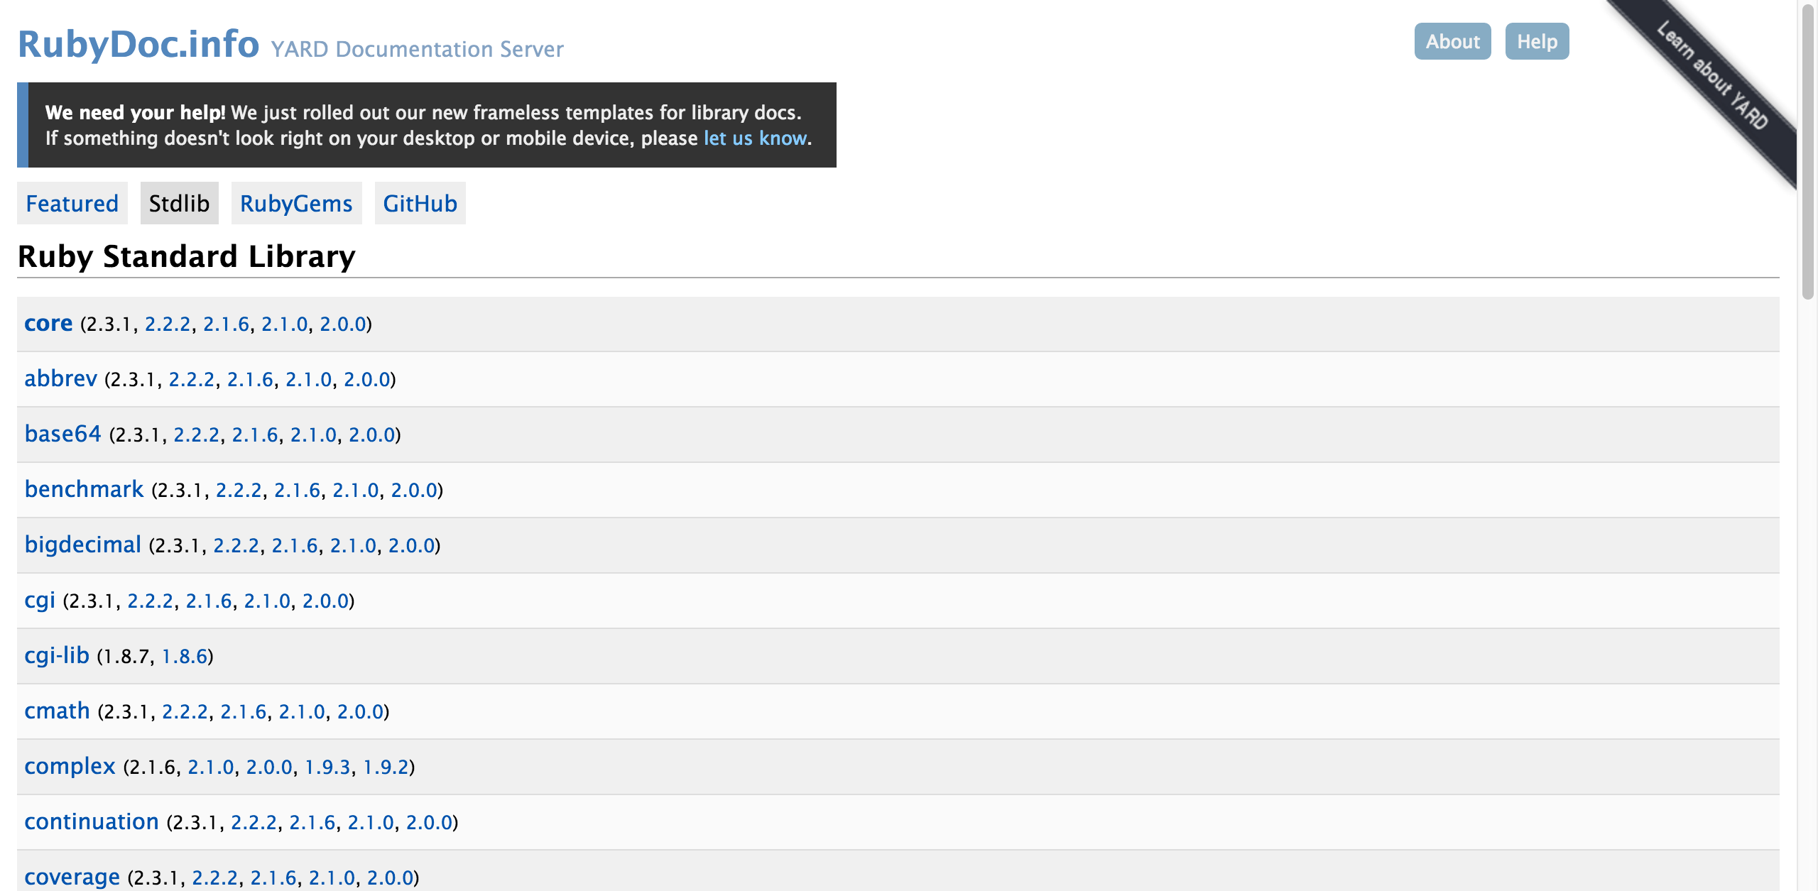
Ruby Documentation
www.rubydoc.info/stdlib

Slide 34
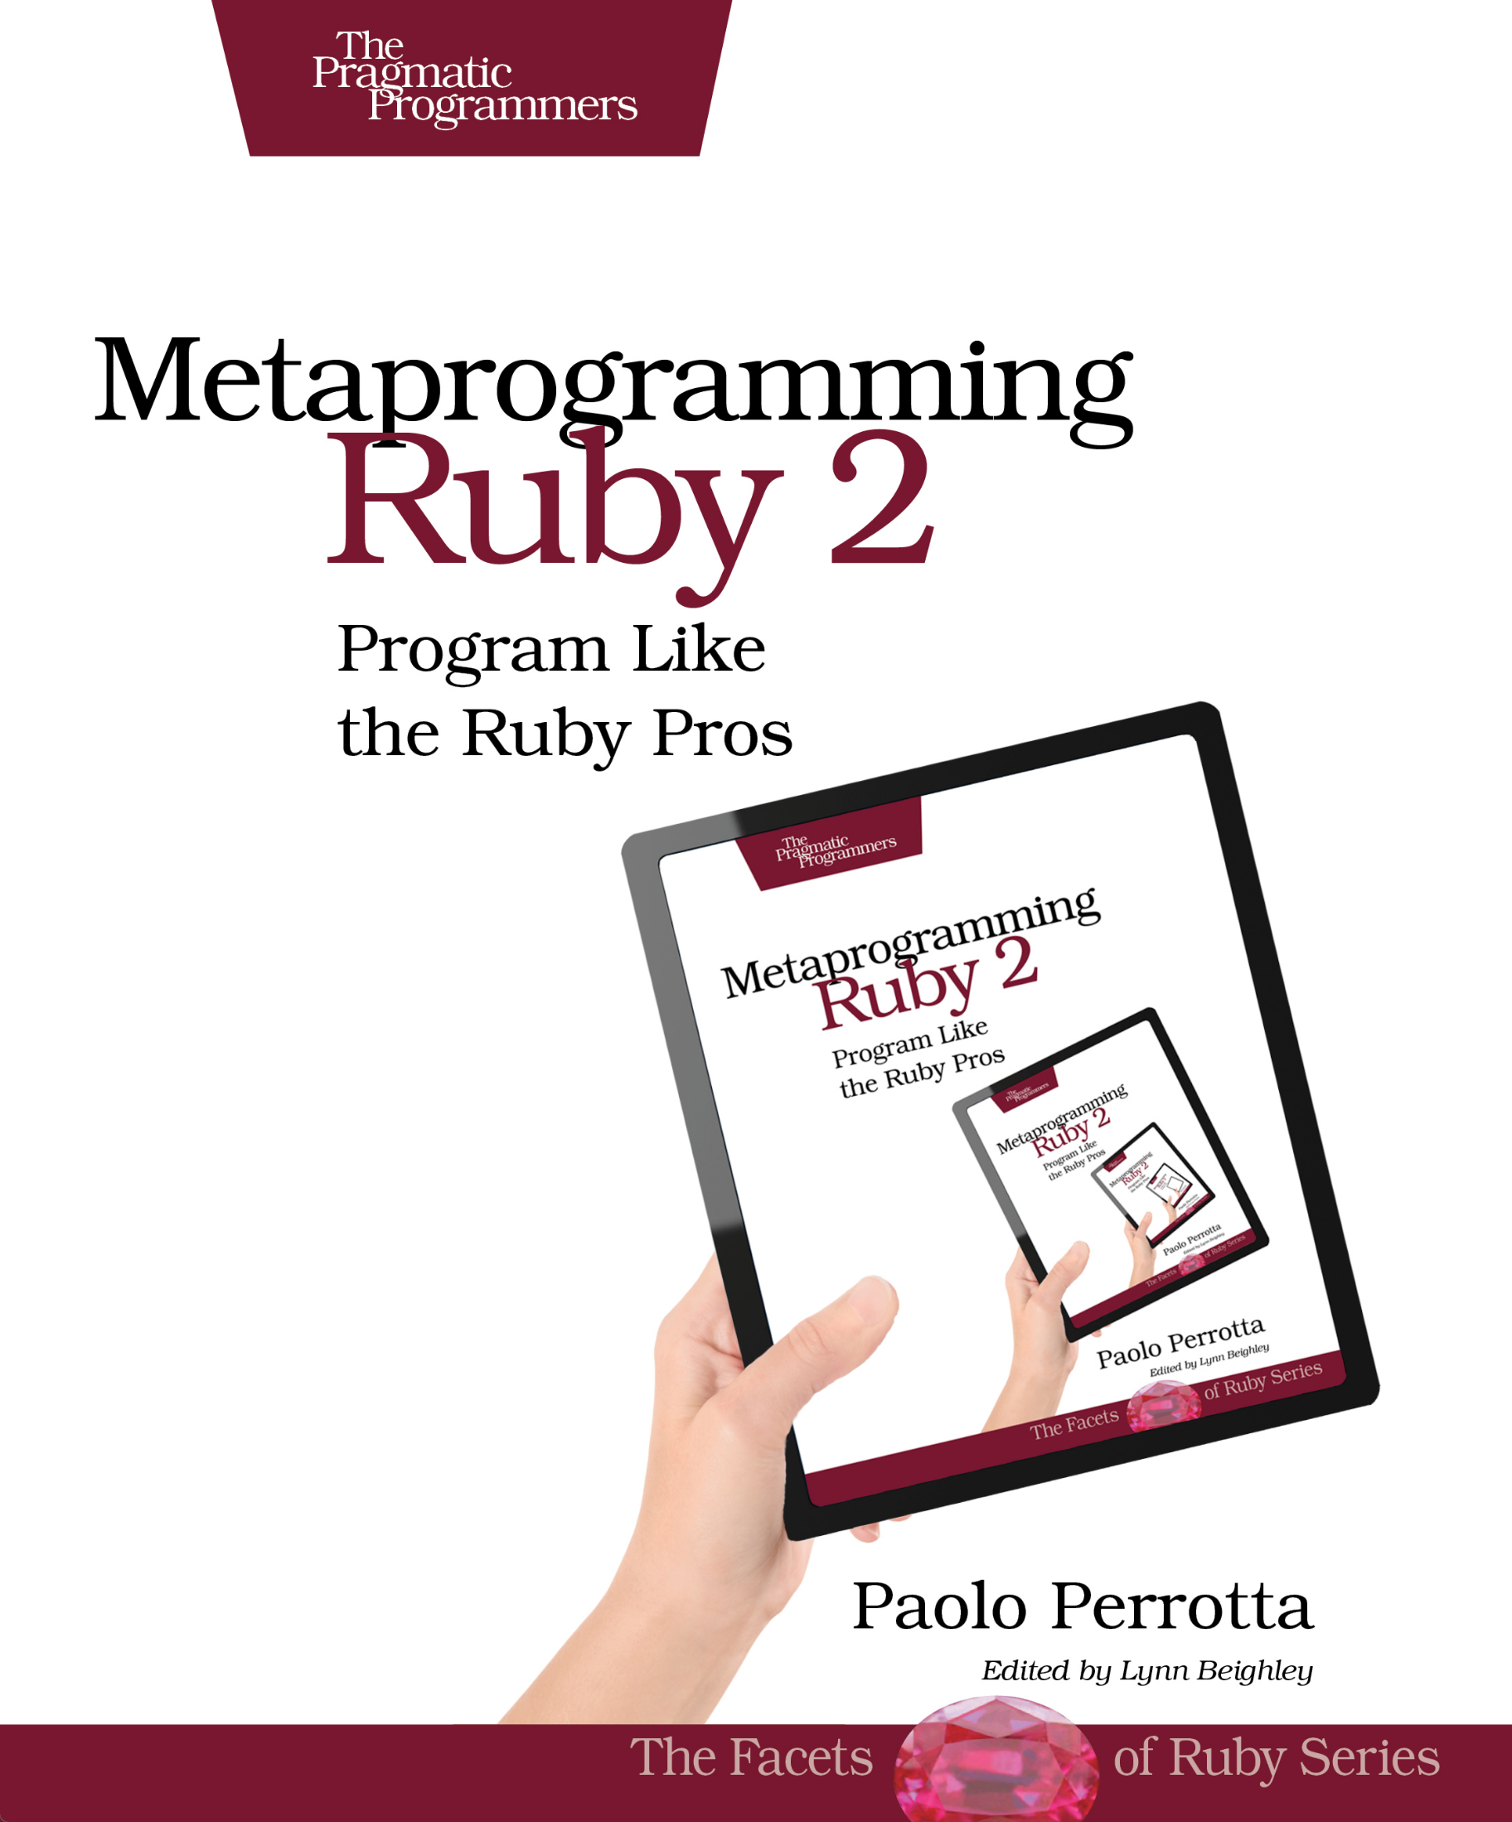
Metaprogramming Ruby 2
pragprog.com/book/ppmetr2/metaprogramming-ruby-2

Slide 35
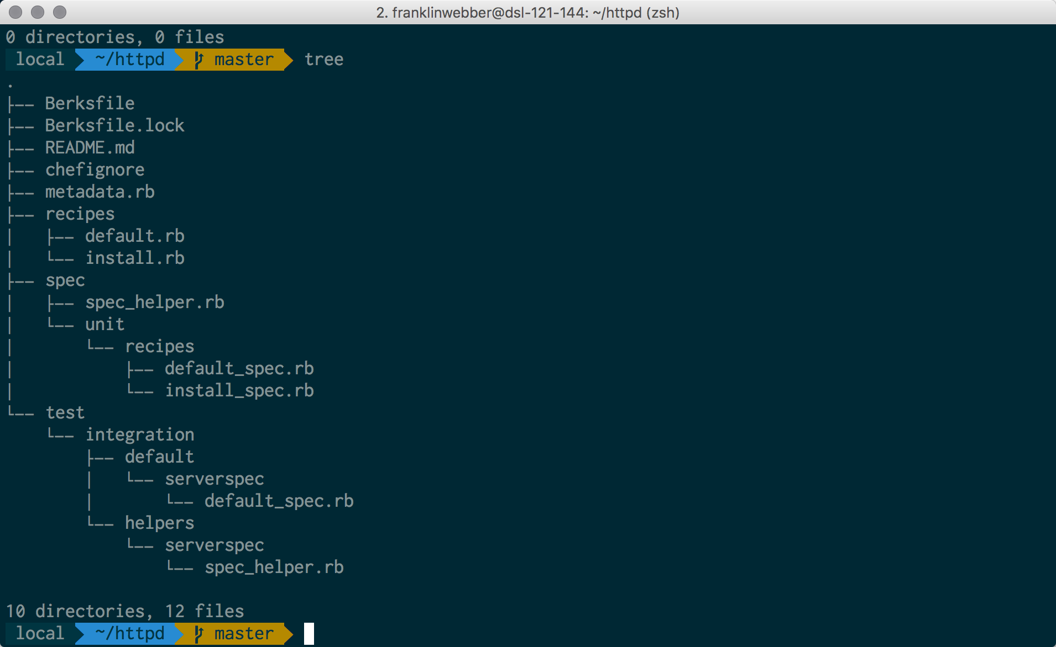
My Terminal
Mac OSX
iTerm2
Oh My Zsh
Agnoster Theme
Powerline Patched Font

Slide 36
Agenda
A Look Behind Resources
A Look Behind Attributes
The Power of Mixins
Questions
Further Resources

